Slide 1
LOAN –STATUS PREDICTION USING MACHINE LEARNING
Shivaleela K - 232126
Shradha – 232127
Sweedal – 232128
Sooraj - 232129

Slide 2
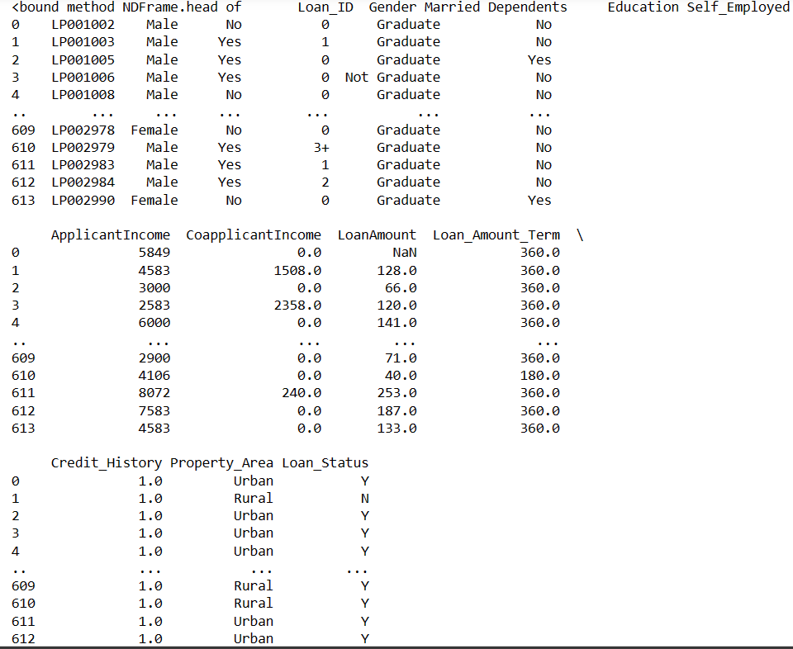
Importing Data and Libraries
import pandas as pd
import numpy as np
import matplotlib.pyplot as plt
data= pd.read_csv("C:/Users/Shivaleela Koodlappa/Desktop/Second sem/Machinelearning/loan_data.csv")
data
Output:

Slide 3
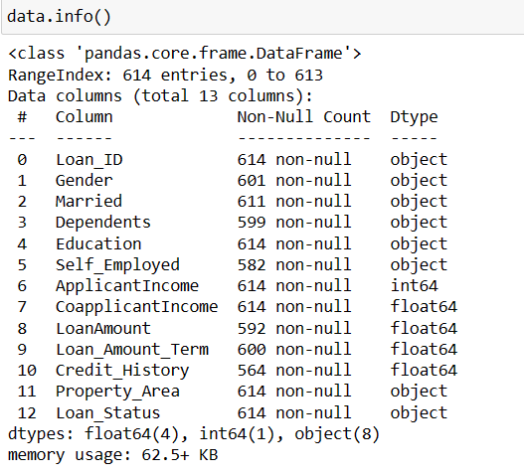
Getting Information:

Slide 4

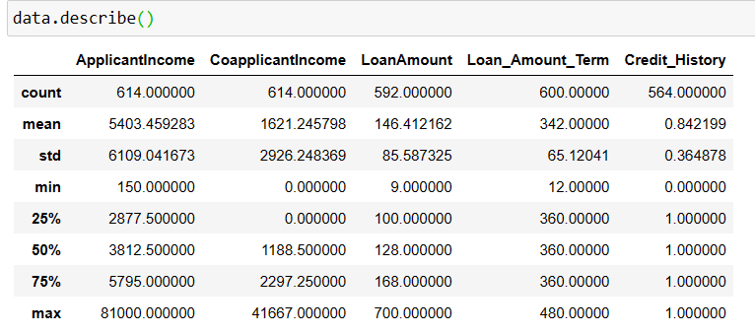
Finding How many Rows and columns are present in our data set:

Slide 5
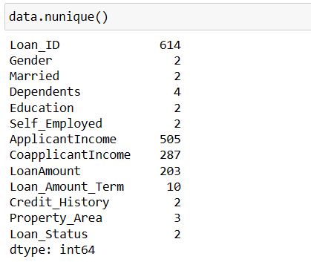
Getting Unique value from the dataset

Slide 6
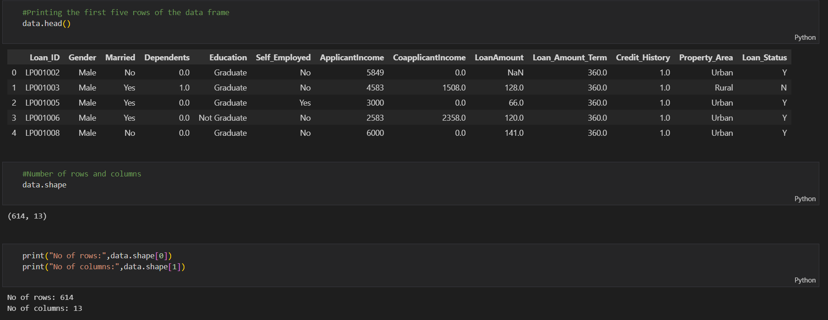
Data Preprocessing :

Slide 7
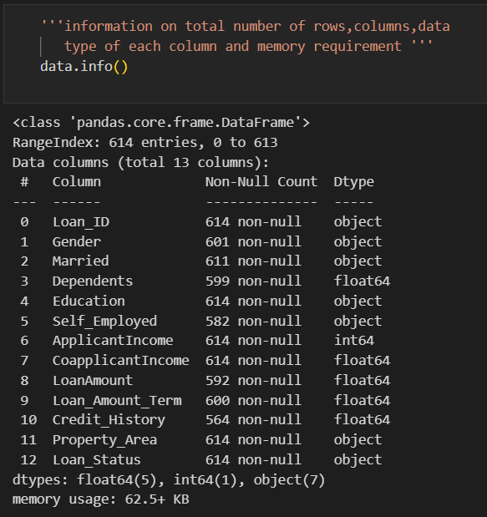
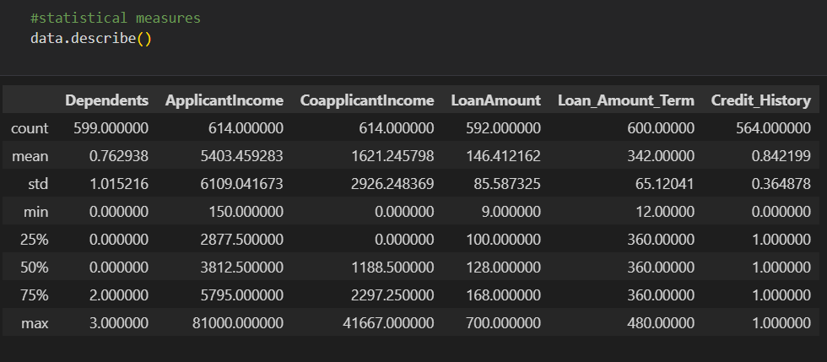

Slide 8
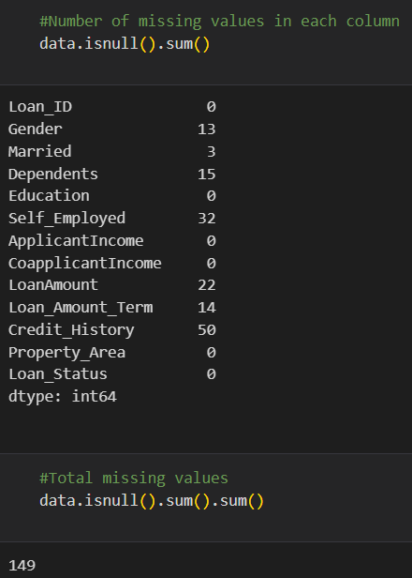
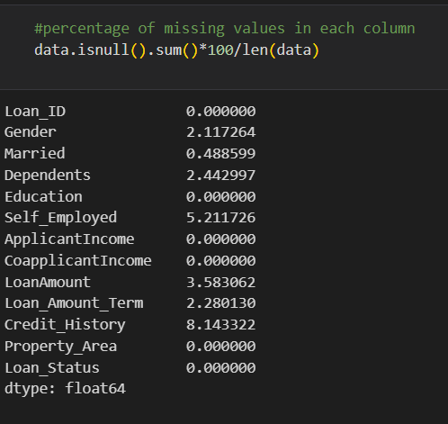

Slide 9
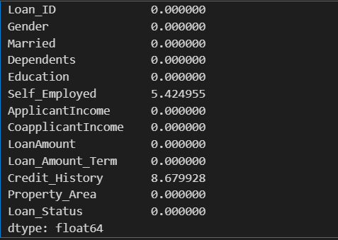
#List of columns having missing values less than 5%.
columns=['Gender','Married','Dependents','LoanAmount','Loan_Amount_Term']
#Dropping the above listed columns
data=data.dropna(subset=columns)
#Percentage of missing values in the columns
data.isnull().sum()*100/len(data)
Output :

Slide 10
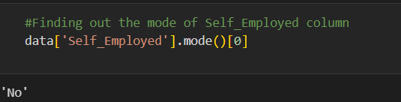
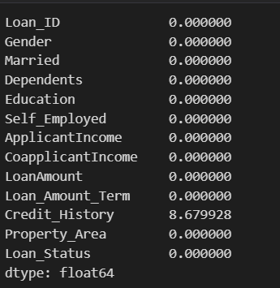
#Percentage of missing values in the columns
data.isnull().sum()*100/len(data)

Slide 11
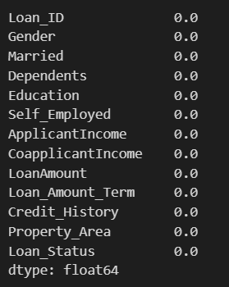
#Finding out the mode of Credit_History column
data['Credit_History'].mode()[0]
#Filling the Credit_History column with its mode
data['Credit_History']=data['Credit_History'].fillna(data['Credit_History'].mode()[0])
#Percentage of missing values in the columns
data.isnull().sum()*100/len(data)

Slide 12
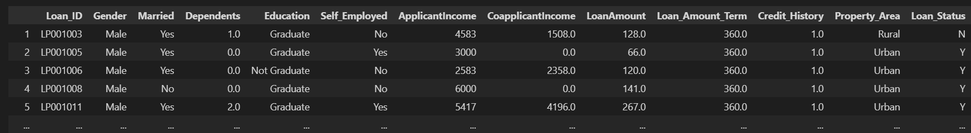
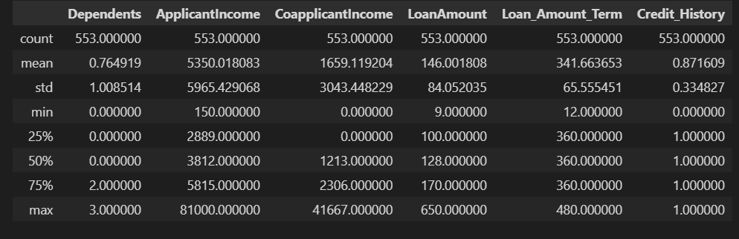
#Displaying the dataframe after treating the missing values
data
#Finding out shape of the dataframe after treating the missing values.
data.shape
Output: (553, 13)
#Statistical measures
data.describe()
Output =>>

Slide 13
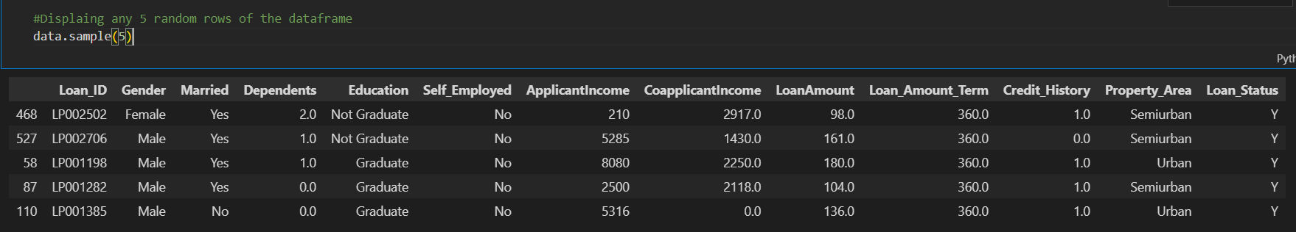
Converting categorical columns to numeric coloumns
#Finding unique values from Dependents column
data['Dependents'].unique()
Output : array([1., 0., 2., 3.])
#Finding unique values from Loan_Status column
data['Loan_Status'].unique()
Output : array(['N', 'Y'], dtype=object)

Slide 14
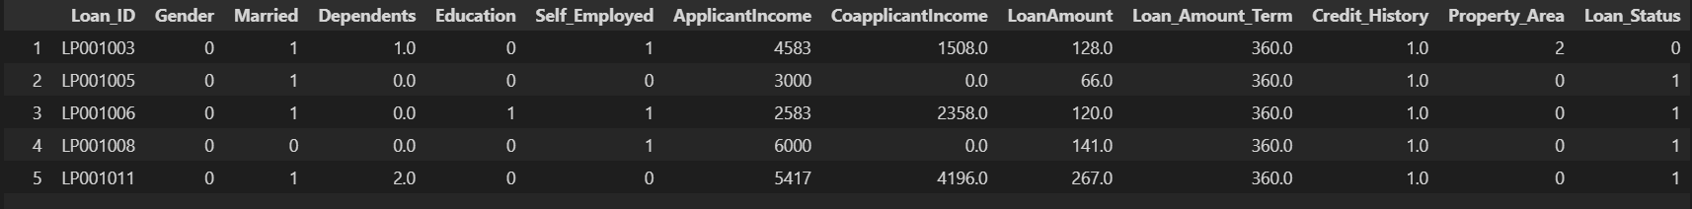
#Label encoding of the categorical columns
data['Gender']=data['Gender'].map({'Male':0,'Female':1})
data['Married']=data['Married'].map({'No':0,'Yes':1})
data['Education']=data['Education'].map({'Graduate':0,'Not Graduate':1})
data['Self_Employed']=data['Self_Employed'].map({'No':1,'Yes':0})
data['Property_Area']=data['Property_Area'].map({'Urban':0,'Semiurban':1,'Rural':2})
#Converting class values to numerical values
data['Loan_Status']=data['Loan_Status'].map({'N':0,'Y':1})
#Displaying data after label encoding.
data.head()
Output:

Slide 15
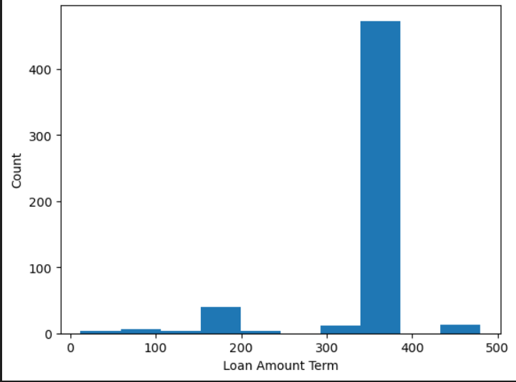
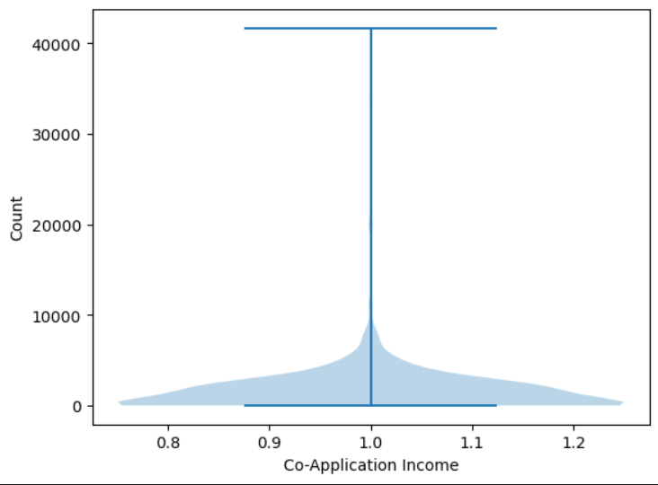
Graphical Representation :Univariate analysis of Numerical Variables
#Histogram => Loan_Amount_Term
plt.hist(data["Loan_Amount_Term"])
plt.xlabel("Loan Amount Term")
plt.ylabel("Count")
# Violinplot => Co Applicant Income
plt.violinplot(data["CoapplicantIncome"])
plt.xlabel("Co-Application Income")
plt.ylabel("Count")

Slide 16
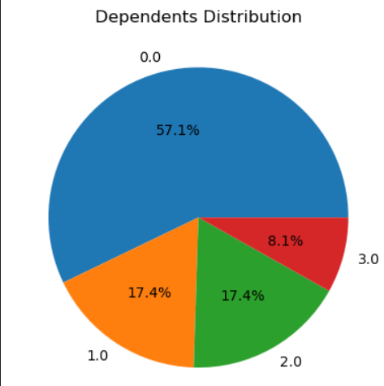
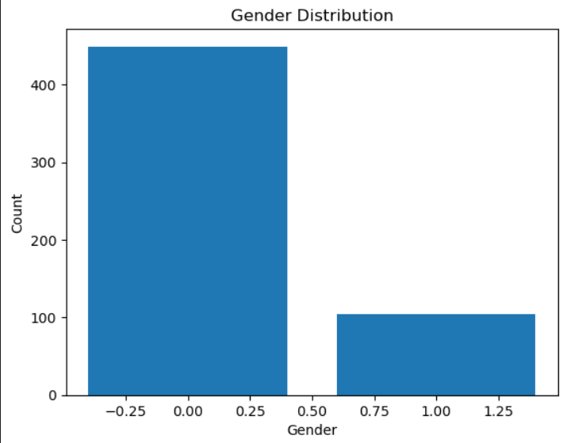
Univariate analysis of categorical variable
# Bar graph => Gender
gender_counts = data['Gender'].value_counts()
plt.bar(gender_counts.index,gender_counts.values)
plt.title("Gender Distribution")
plt.xlabel("Gender")
plt.ylabel("Count")
plt.show()
# Pie chart => Dependents
dependents = data['Dependents'].value_counts()
plt.pie(dependents.values, labels=dependents.index, autopct='%1.1f%%')
plt.title("Dependents Distribution")

Slide 17
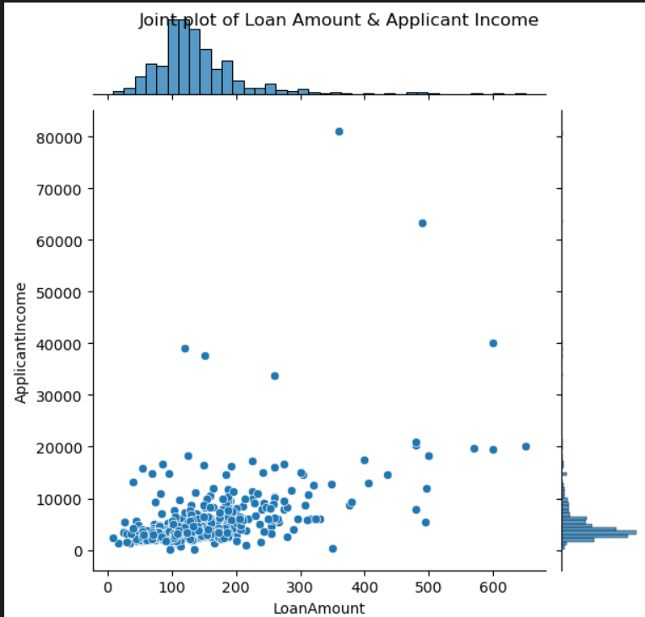
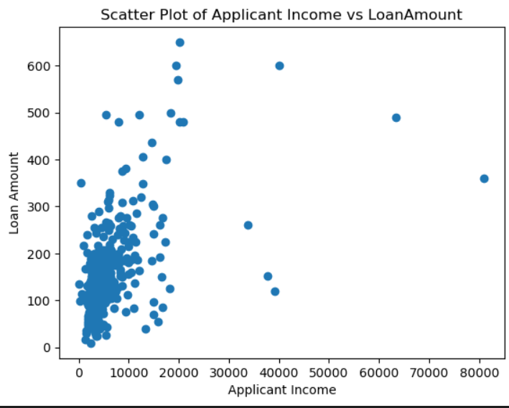
# Scatterplot => Applicant Income & Loan Amount
plt.scatter(data['ApplicantIncome'], data['LoanAmount'])
plt.title("Scatter Plot of Applicant Income vs LoanAmount")
plt.xlabel("Applicant Income")
plt.ylabel("Loan Amount")
plt.show()
# Jointplot => ApplicantIncome & Loan Amount
sns.jointplot(data, x="LoanAmount", y="ApplicantIncome", kind="scatter")
plt.suptitle("Joint plot of Loan Amount & Applicant Income")

Slide 18
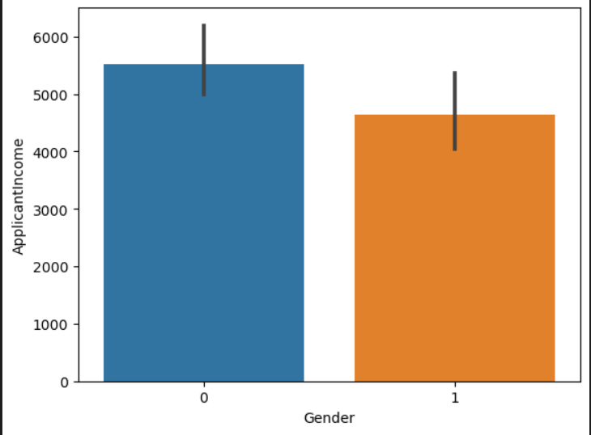
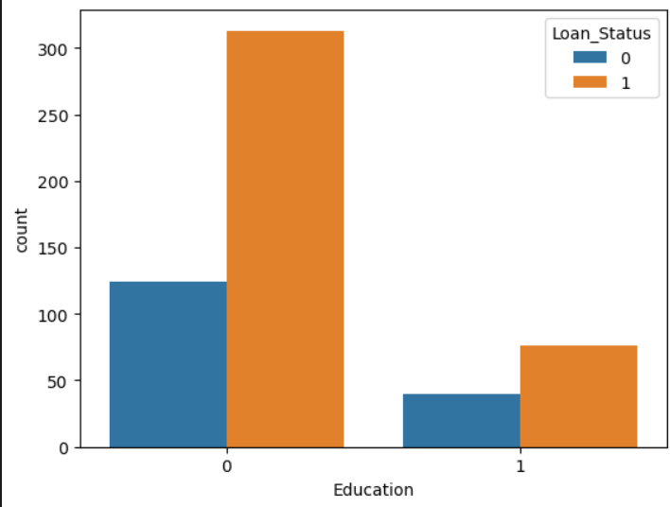
Bivariate Analysis of Categorical Variables :
# Countplot => Education & Loan Status
sns.countplot(data, x="Education", hue="Loan_Status")
# Barplot => Gender & Application Income
sns.barplot(data, x="Gender", y="ApplicantIncome")

Slide 19
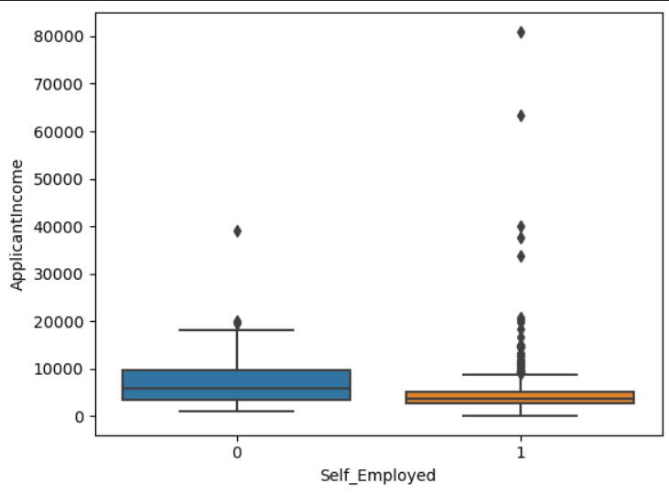
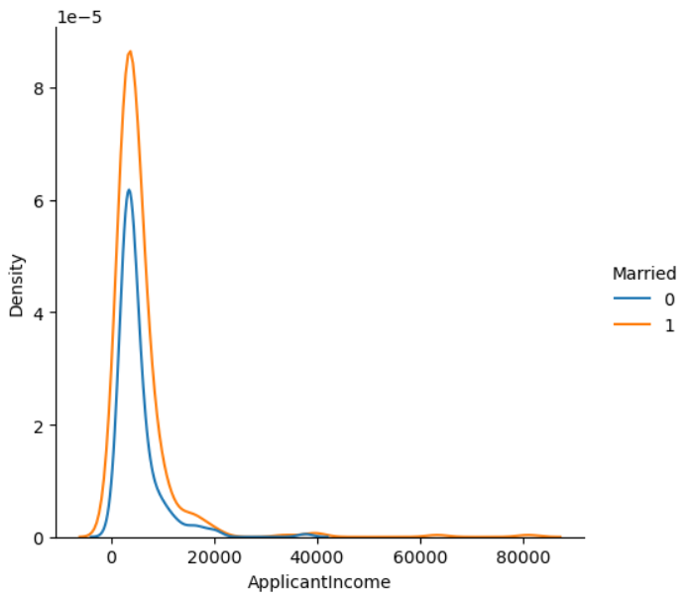
# Boxplot => Self Employed & Application Income
sns.boxplot(data, x="Self_Employed", y="ApplicantIncome")
# Displot => Applicant Income & Married
sns.displot(data, x= "ApplicantIncome", hue="Married", kind="kde")

Slide 20
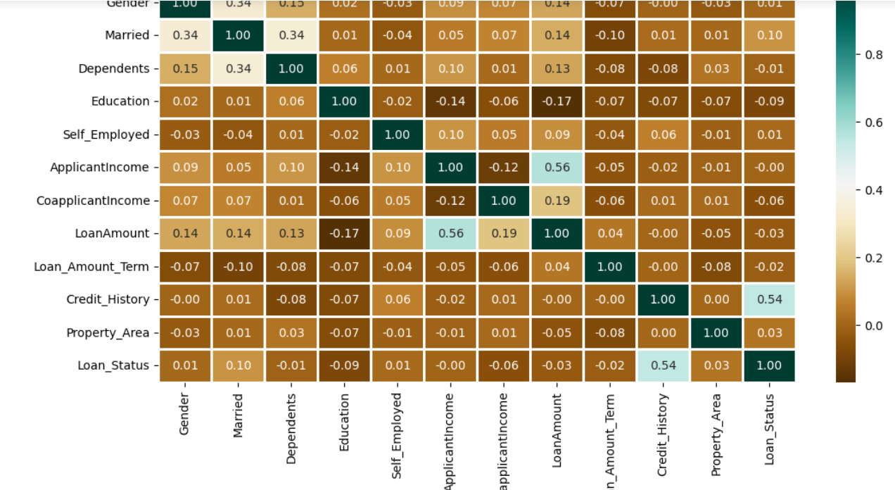
Multivariate Analysis :
#Heatmap => All numerical data
num_df = data.select_dtypes(include=['number'])
sns.heatmap(num_df.corr(), annot=True)
plt.title("Correlation Heatmap for all Numerial Variables")

Slide 21
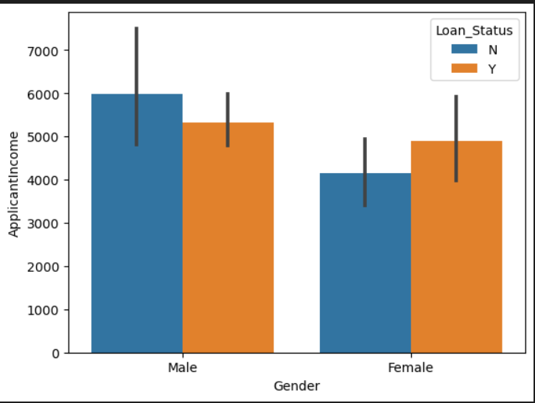
# Barplot => Gender, Application Income, Loan Status
sns.barplot(data, x="Gender", y="ApplicantIncome", hue="Loan_Status")

Slide 22
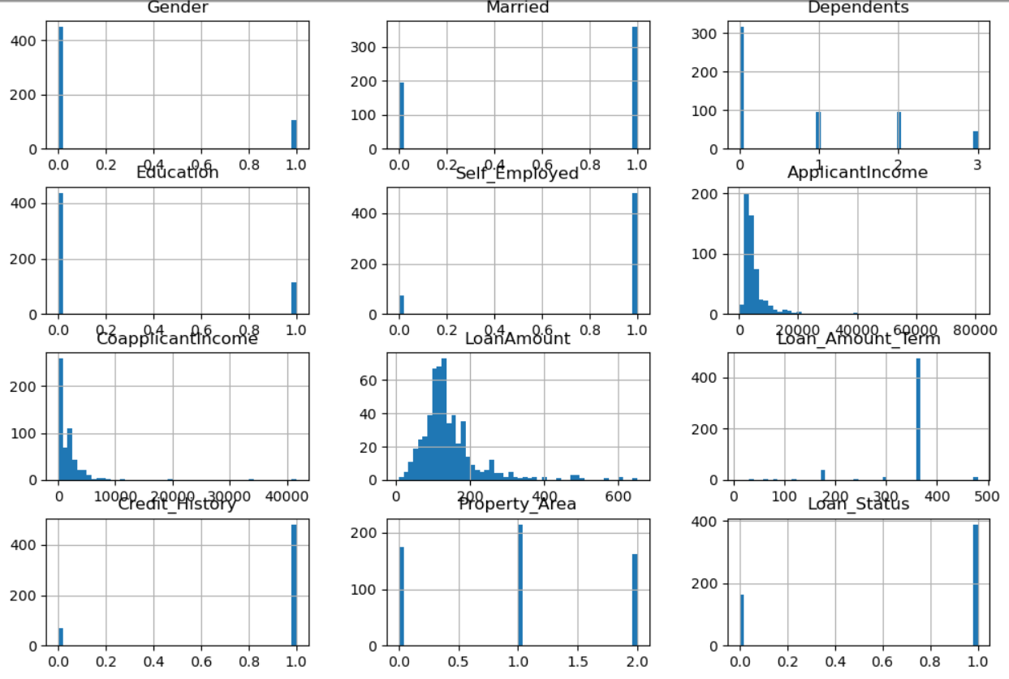
# hist() => All numeric variables
data.hist(bins=50, figsize=(12, 8))

Slide 23
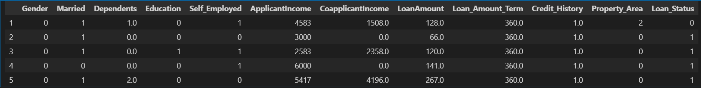
Store feature matrix in x and target (response) variable in y vector
#Drop the loan_id column from the dataframe.
data=data.drop('Loan_ID',axis=1)
#Displaying the first 5 records after droping the loan_id column
data.head()
#Creating the new data frame with all the attributes accept for class attribute
X=data.drop('Loan_Status',axis=1)
#Storing the Loan_status or class data in variable y
Y=data['Loan_Status']
#Print X dataframe
print(X)

Slide 24
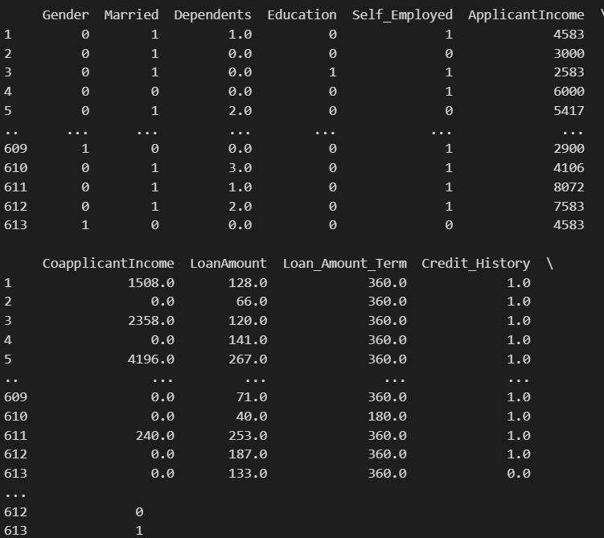
Output:

Slide 25
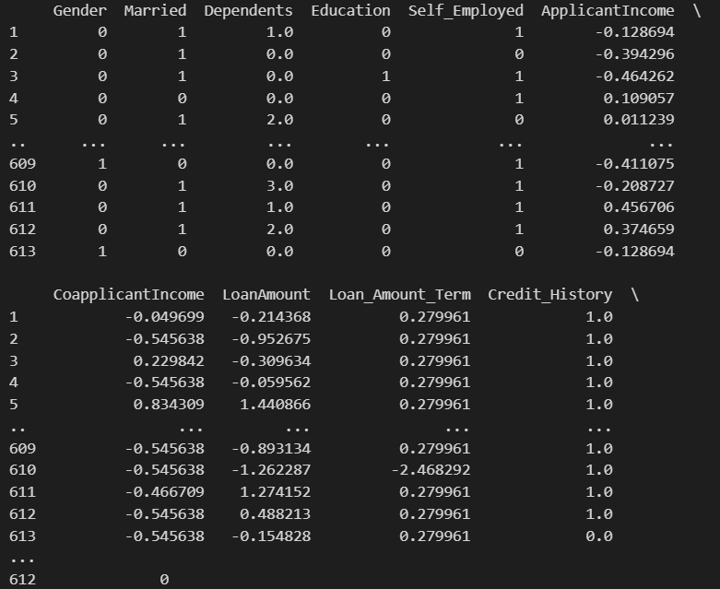
Feature Scaling :
#Selecting the columns which require scaling
cols=['ApplicantIncome','CoapplicantIncome','LoanAmount','Loan_Amount_Term']
#Importing library which is reqiured for scaling
from sklearn.preprocessing import StandardScaler
#Performing feature scaling
st=StandardScaler()
X[cols]=st.fit_transform(X[cols])
print(X)

Slide 26
Splitting the dataset into train and test data and applying K-Fold Cross Validation
#Defing the function to train and test data and applying K-Fold Cross Validation.
model_df={}
def model_val(model,X,Y):
x_train,x_test,y_train,y_test=train_test_split(X,Y,test_size=0.20,random_state=42)
model.fit(x_train,y_train)
y_pred=model.predict(x_test)
print(f'{model} accuracy score is {accuracy_score(y_test,y_pred)}')
#5 Fold Cross Validation.
score=cross_val_score(model,X,Y,cv=5)
print(f'{model} average cross val score is {np.mean(score)}')
model_df[model]=round(np.mean(score)*100,2)
# LogisticRegression
from sklearn.linear_model import LogisticRegression
model=LogisticRegression()
model_val(model,X,Y)
Output :

Slide 27

#SVM:
from sklearn import svm
model=svm.SVC()
model_val(model,X,Y)
Output :
#DecisionTreeClassifier
from sklearn.tree import DecisionTreeClassifier
model=DecisionTreeClassifier()
model_val(model,X,Y)
Output :

Slide 28
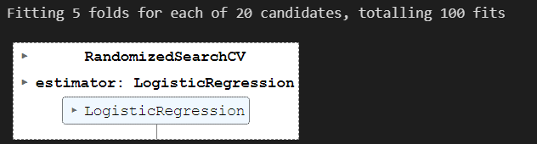
Hyperparameter tuning :
from sklearn.model_selection import RandomizedSearchCV
Logistic Regression :
log_red_grid={"C":np.logspace(-4,4,20),"solver":['liblinear']}
rs_log_reg=RandomizedSearchCV(LogisticRegression(),param_distributions=log_red_grid,n_iter=20,cv=5,verbose=True)
rs_log_reg.fit(X,Y)
Best score
rs_log_reg.best_score_
Output : 0.802964782964783
rs_log_reg.best_params_
Output: {'solver': 'liblinear', 'C': 0.23357214690901212}

Slide 29
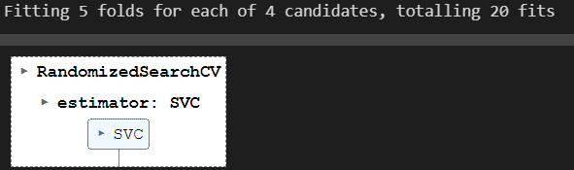
SVM : Support Vector Machine
svc_grid={'C':[0.25,0.50,0.75,1],"kernel":["linear"]}
rs_svc=RandomizedSearchCV(svm.SVC(),param_distributions=svc_grid,
n_iter=20,cv=5,verbose=True)
rs_svc.fit(X,Y)
Output:
Best score :
rs_svc.best_score_
rs_svc.best_params_
Output : 0.8066011466011467
Output : {'kernel': 'linear', 'C': 0.25}

Slide 30
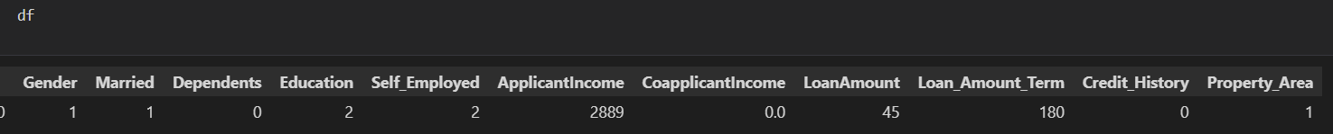

#save the model
import joblib
joblib.dump(rf,'loan_status_prediction')
model=joblib.load('loan_status_prediction')
import pandas as pd
df=pd.DataFrame({'Gender':1,'Married':1,'Dependents':0,'Education':2,'Self_Employed':2,'ApplicantIncome':2889,'CoapplicantIncome':0.0,'LoanAmount':45,'Loan_Amount_Term':180,
'Credit_History':0,'Property_Area':1},index=[0])
#Predictiong The Results
result=model.predict(df)
print(result)
if result==1:
print("Loan is approved")
else:
print("Loan is not approved")
Output :

Slide 31
Thank You

